Slide 1
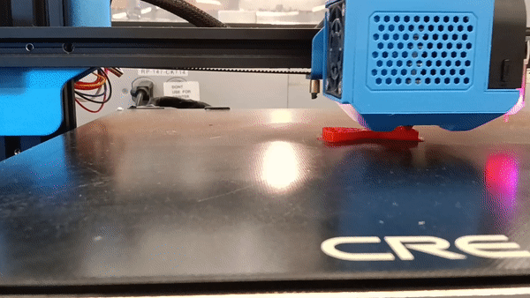
DEHub FDM Testbed
11/15/2024
Ahmed Ben Sidhom
Electrical and Computer Engineering PhD candidate
Advisor: Dr. Antonios Kontsos
Director, Digital Engineering Hub (DEHub)​
Henry M. Rowan Foundation Professor ​
Dept. of Mechanical Engineering​
Dept. of Electrical Engineering (courtesy)​
Materials Science & Engineering (affiliated)​
Henry M. Rowan College of Engineering (HMRCOE)

Slide 2
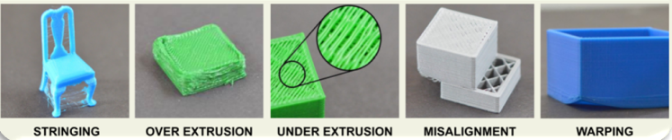
Introduction
3D printing represents a significant leap forward in additive manufacturing technology. Despite its promising capabilities, the printing process often encounters various challenges, leading to frequent failures. These issues, such as under extrusion, stringing, and spaghettification, are diverse and recurrent, significantly impeding the seamless execution of print jobs. Consequently, these common errors pose substantial hurdles to the reliability and efficiency of 3D printing technology. These deficiencies can be rectified by having a closed-loop monitoring system, that can see defects and adjust printing properties to remove this defect from the rest of the print.
Example of 3D-Printing Defects

Slide 3
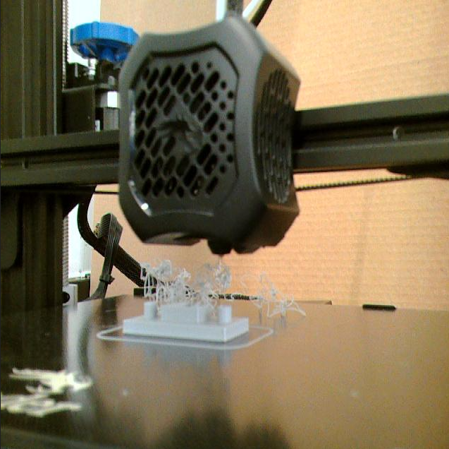
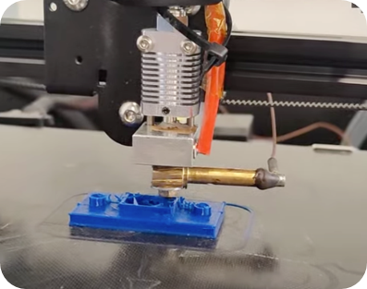
Proposed Solution
Improve quality control in 3D printing by integrating real-time image analysis and acoustic emission sensing, enhanced through machine learning techniques:
Detecting and classifying defects in 3D-printed parts by analyzing images captured during the printing process in real time.
Identifying defect occurrence during printing using an acoustic sensor attached to the nozzle, providing real-time feedback on potential issues.

Slide 4
Proposed Solution
This approach leverages the strengths of each method to offer complementary insights into the print condition:
Camera-based Computer Vision: Allows us to detect visible defects, such as layer misalignment, surface irregularities, or unexpected material build-up. By analyzing these images in real time, we can identify anomalies that are visually detectable, providing a reliable, immediate indication of certain types of physical defects as they occur.
Acoustic Emission (AE) Sensors: Detect high-frequency sound waves generated by subtle changes within the material that might not be visible, such as micro-cracks or material stress. This acoustic data enables us to identify structural issues that are hidden from the camera’s view.
By combining these two methods, we gain a fuller picture of the 3D printing process. This dual approach allows for a more robust, non-destructive monitoring system that enhances reliability and print quality assurance.

Slide 5
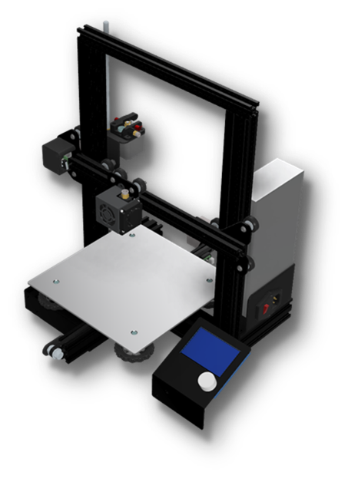
Proposed Solution
Tools
3D Printer : Creality Ender 3 Pro
Printer Type​ | Fused Deposition Modeling (FDM)​
Build Volume​ | 220 x 220 x 250mm​
Print Head​ | Single​
XY Axis Accuracy​ | 0.1 mm​
Max Print Speed​ | 180 mm/s​
Nozzle Diameter​ | 0.4 mm​
Consumables​ | 1.75mm PLA, TPU, ABS​
Layer Resolution​ | 0.1 - 0.4 mm​

Slide 6
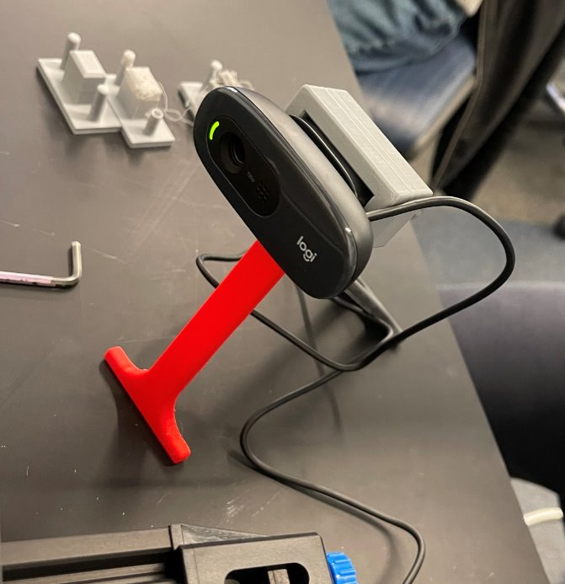
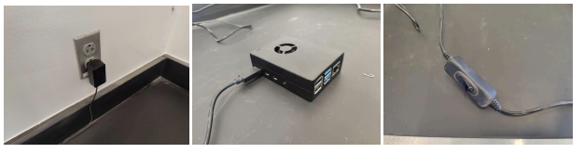
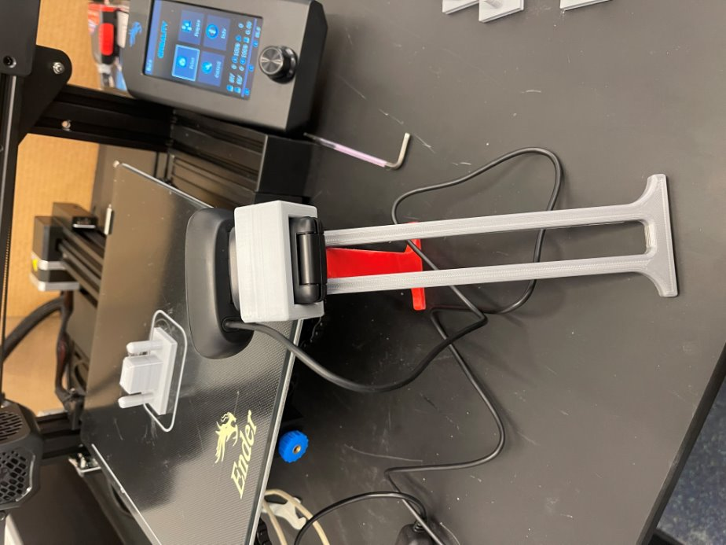
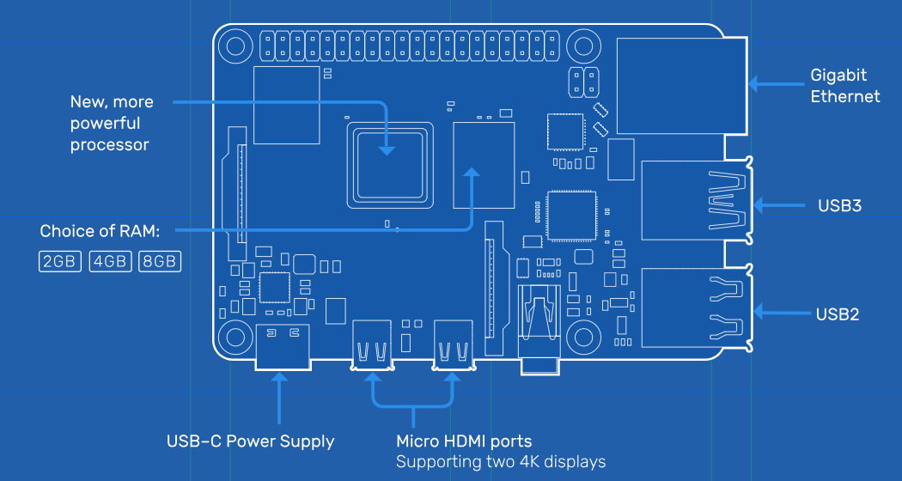
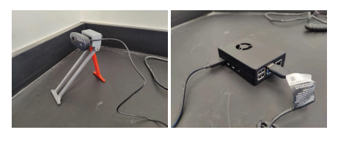
Proposed Solution
Tools
Camera: Logitech C270
Raspberry Pi4

Slide 7
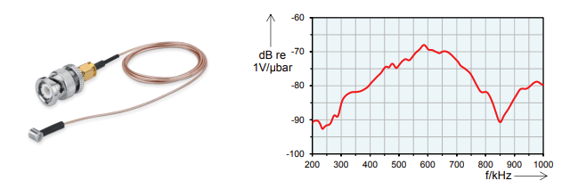
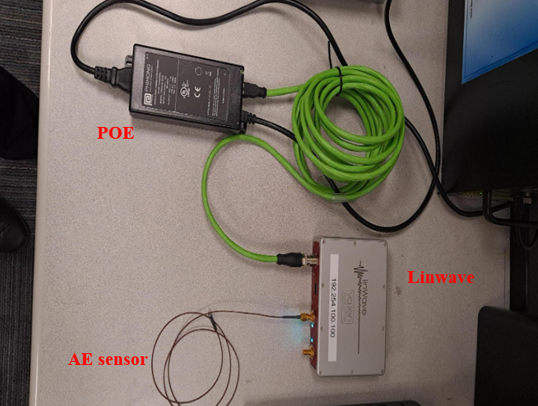
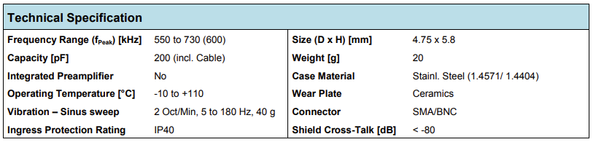
Proposed Solution
Tools
AE sensor: VS600-Z1
AE DAQ: Linwave

Slide 8
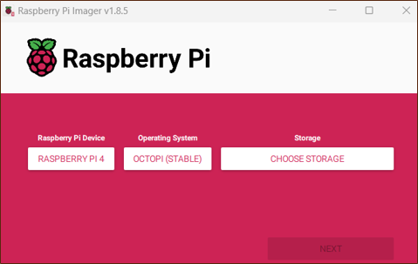
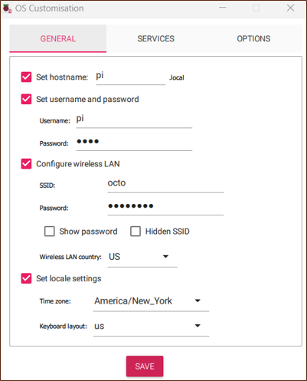

Proposed Solution
Tools
Octopi
OctoRest
Octoprint
OctoPrint

Slide 9

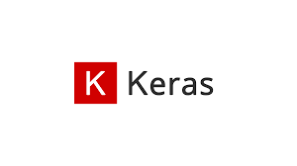

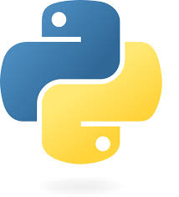


Proposed Solution
Tools
Anaconda/Python/TensorFlow, Keras, Pytorch, Numpy…

Slide 10
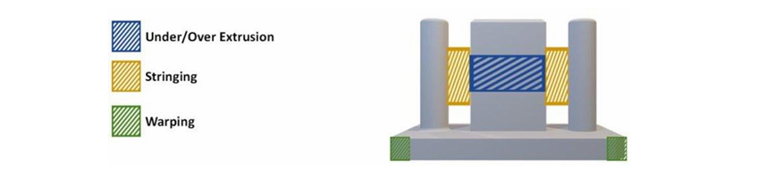
Defect Generation for Training
The geometry used to test these errors was a set of two cylindrical pillars with a rectangular tower in the middle.
To simulate under-extrusion, the g-code was modified to reduce the extrusion rate.
Stringing errors were induced by increasing the printing temperature and disabling retraction in Cura.
Spaghettification errors were generated by instructing the printer to create layers in midair, causing the extruded plastic to lack support and form long curls across the print bed.
Proposed geometry

Slide 11
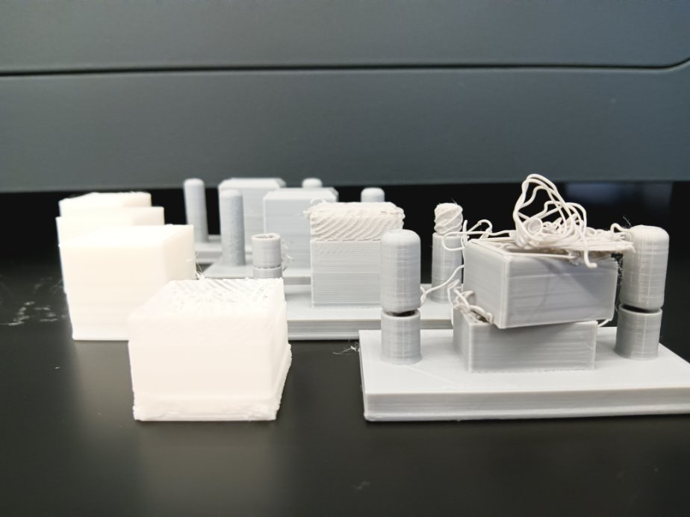
Defect Generation for Training
Property​ | Value​
Layer Height ​ | 0.2mm​
Wall Count ​ | 2​
Top & Bottom Layers ​ | 4​
Infill ​ | %10​
Infill Pattern​ | Cubic​
Nozzle Temperature ​ | 200.0 °C ​
Build Plate Temperature​ | 60.0 °C ​
Flow​ | 100% ​
Speed​ | 50 mm/s​
Build Plate Adhesion Type ​ | Skirt ​
Skirt Line Count​ | 3​
The object was sliced in Cura using default settings, representing a standard configuration for many 3D printers

Slide 12
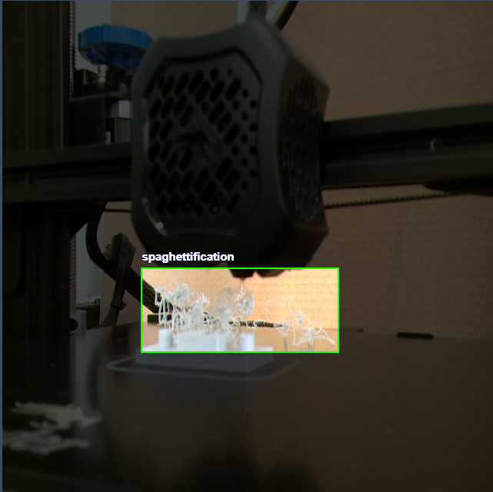
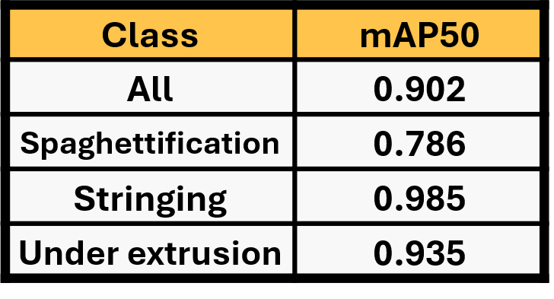
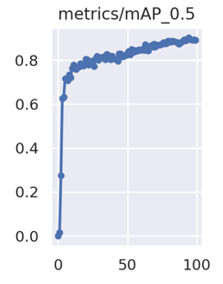
Approach 1: Computer Vision
Images are captured during the printing process to detect purposely created defects by altering the G code, then the collected data is used to train an object detection model YOLOv5s
Data Labeling and splitting
Model Training and evaluation
YOLO5s results

Slide 13

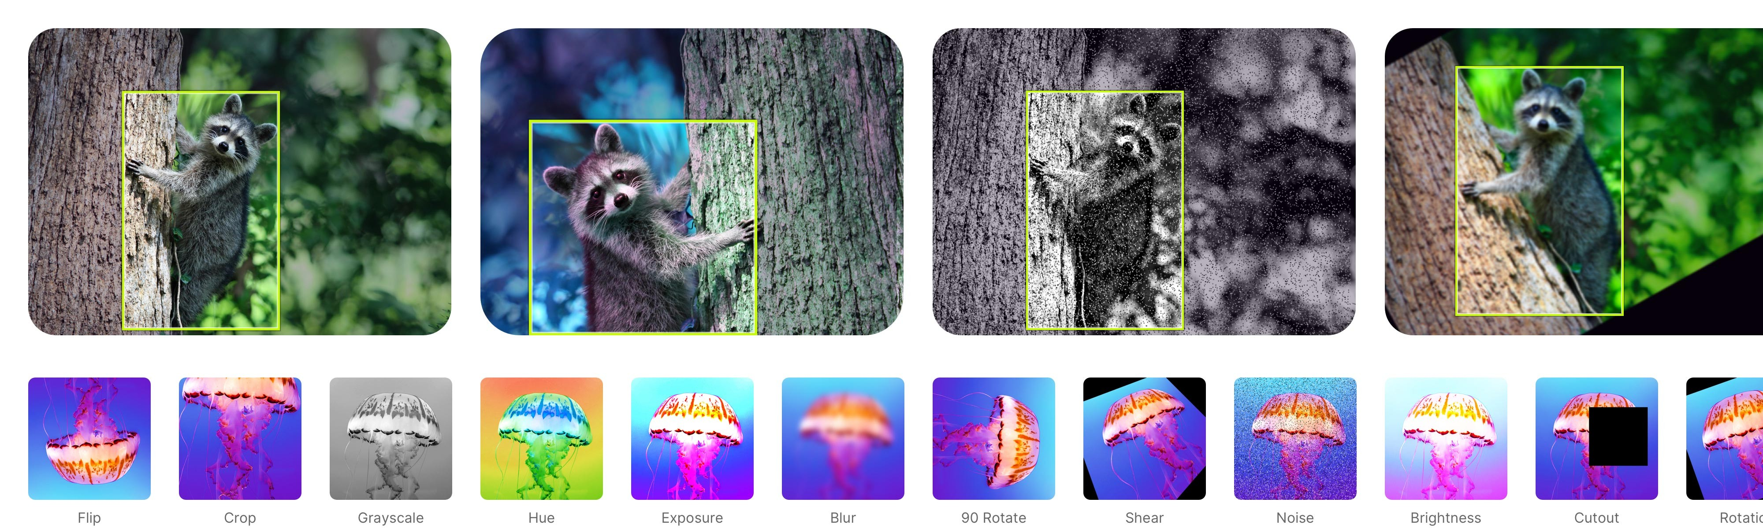
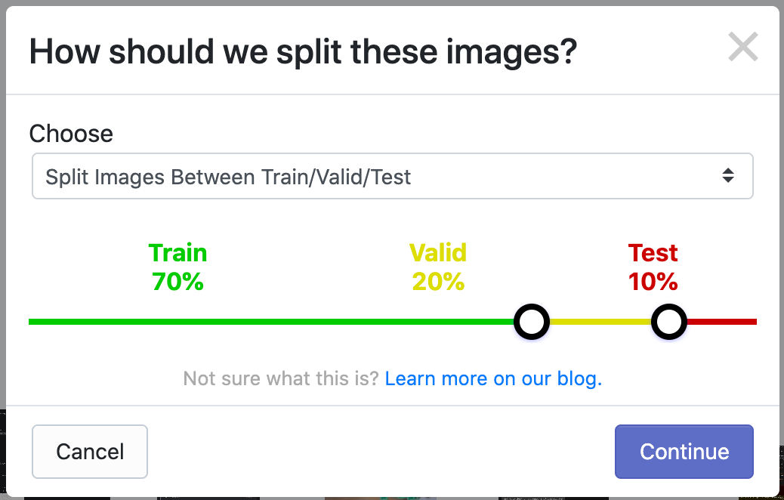
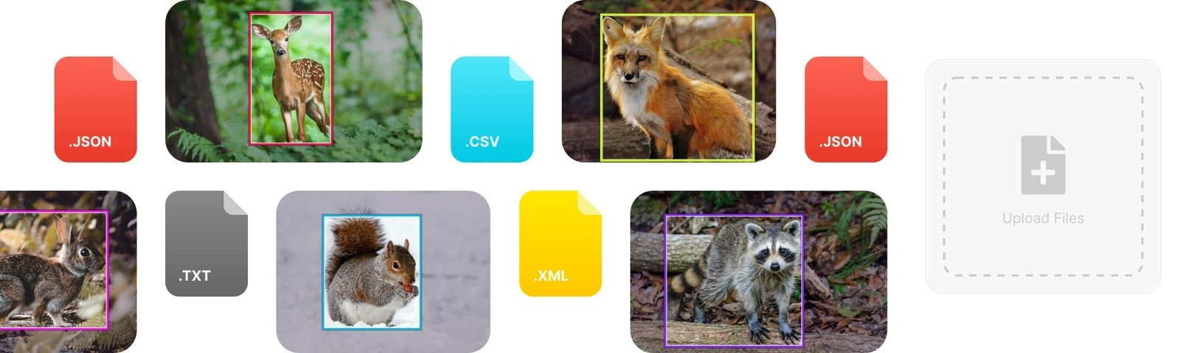
Approach 1: Computer Vision
Team accessible data handling tool

Slide 14
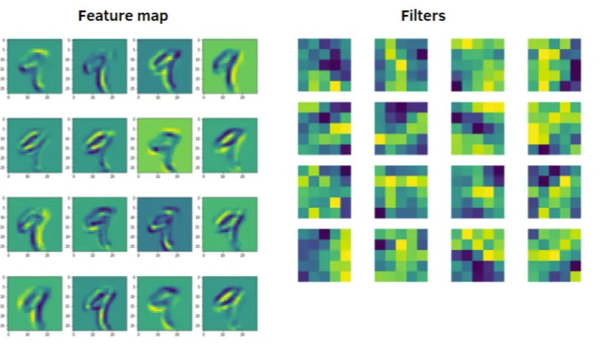
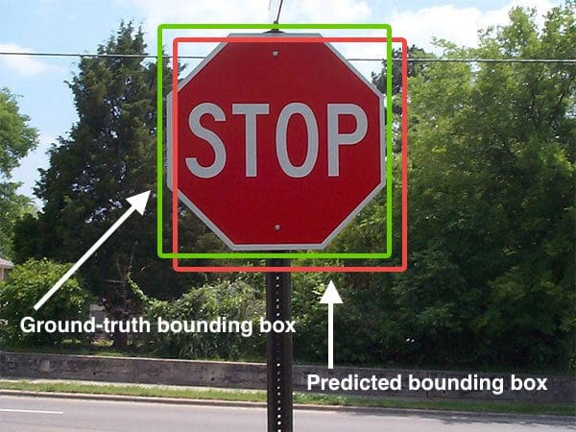
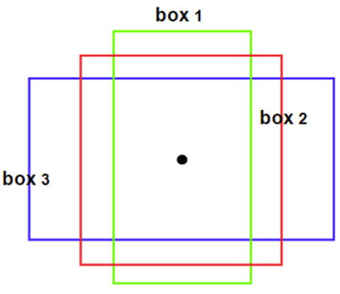
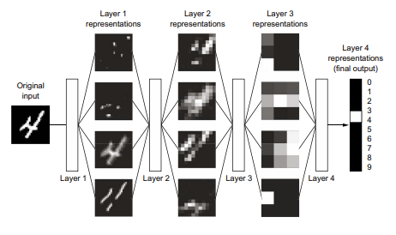
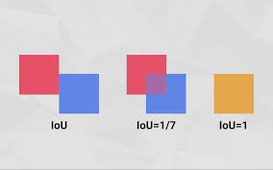
Approach 1: Computer Vision
Architectures: CNNs
Techniques: Anchor Boxes
Results: Object detection

Slide 15
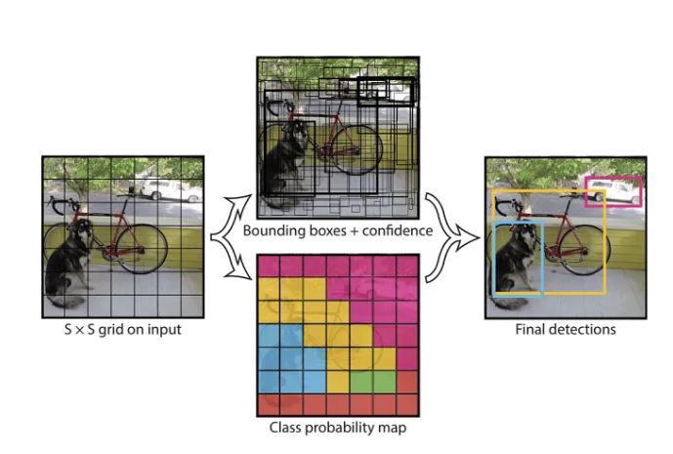
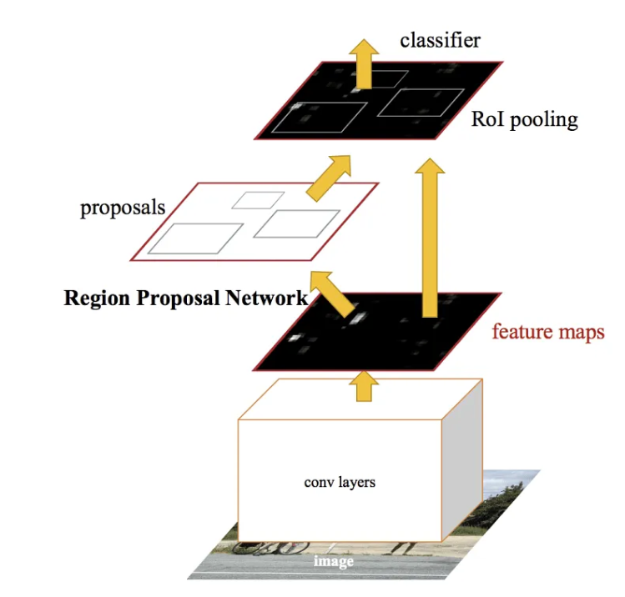
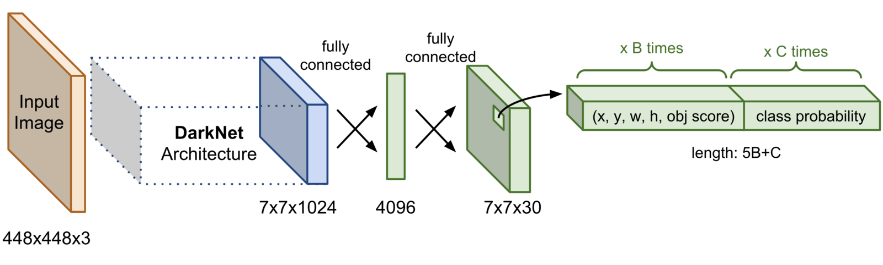
Approach 1: Computer Vision
YOLO
Faster-RCNN

Slide 16
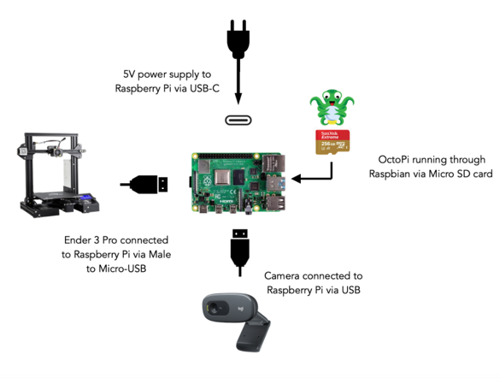
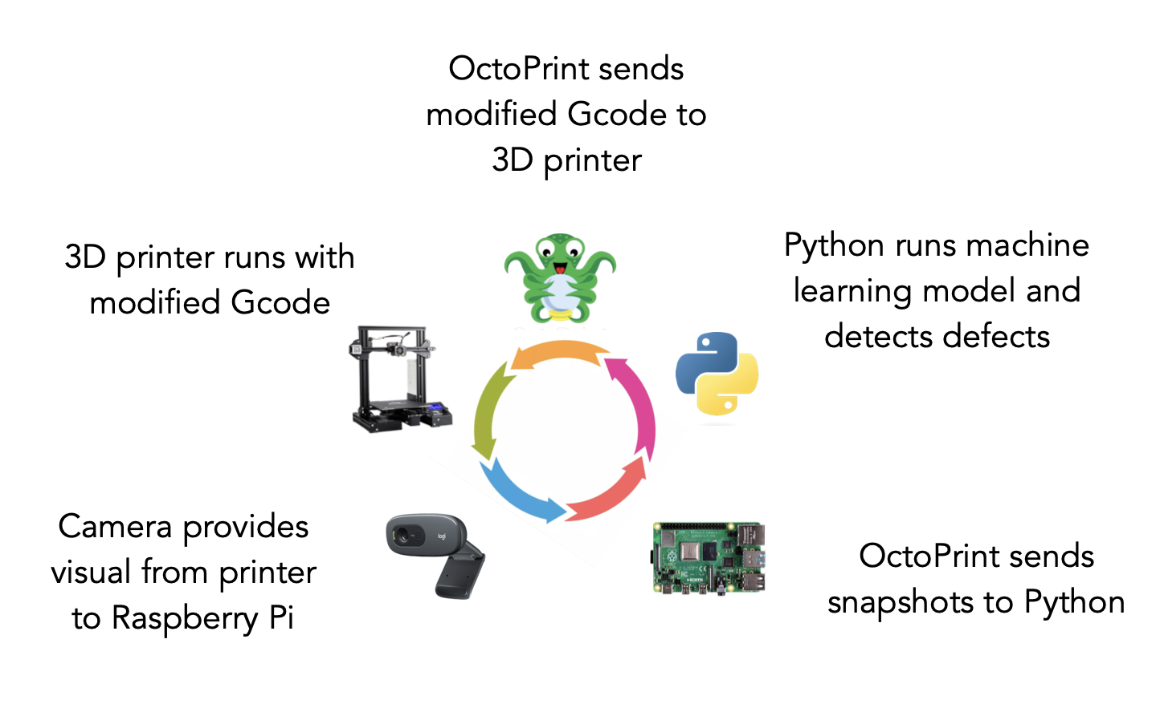
Approach 1: Computer Vision
Deployment and Closed-loop setup
Upon detection, commands are sent through OctoPrint installed on a RaspberryPi to adjust printer settings dynamically, ensuring optimal print quality.

Slide 17



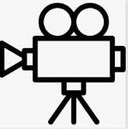


Approach 1: Computer Vision
Deployment and Closed-loop setup
1. Training
Cloud
RoboFlow: Labeling/preprocessing/augmentation/splitting
Octoprint
Dataset
printer
camera
images
Computer
anaconda
Python
Opencv
Numpy
…….
Pytorch
YOLO: Training
YOLO.pt

Slide 18
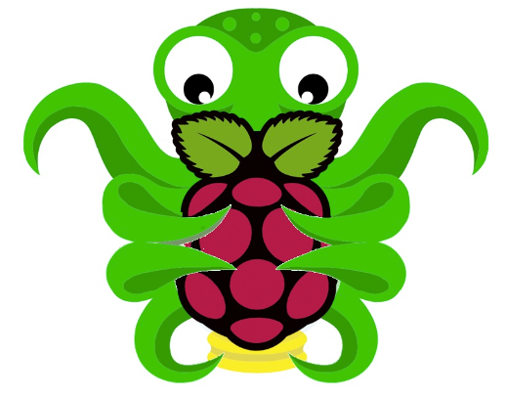
Approach 1: Computer Vision
Deployment and Closed-loop setup
2. Deployment
OctoPi
Raspberry PI4
OctoRest
printer
camera
images
Results
Python
Opencv
Numpy
…….
Pytorch
YOLO.pt: Inference

Slide 19
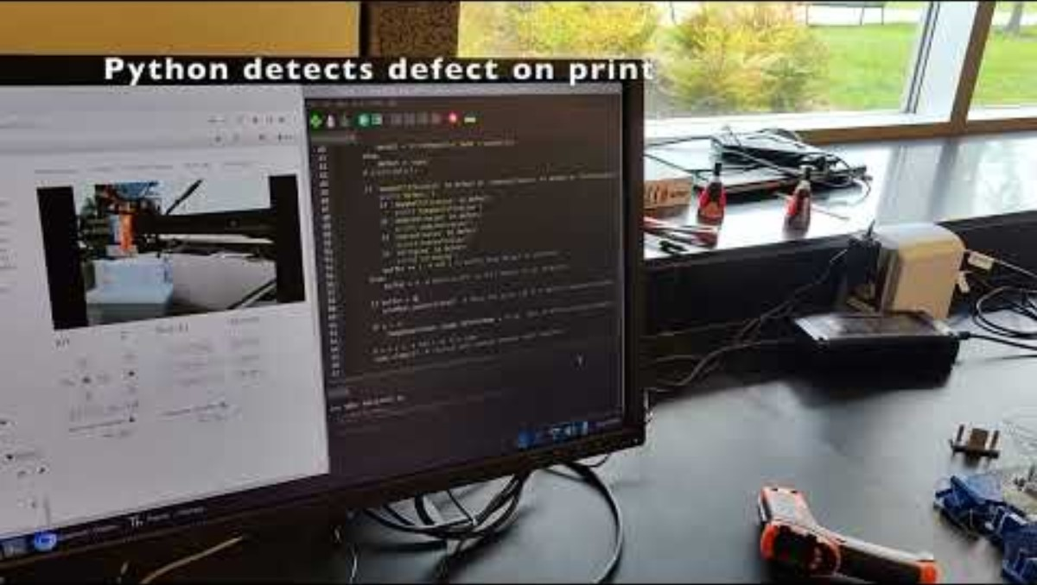
Approach 1: Computer Vision
Deployment and Closed-loop setup

Slide 20
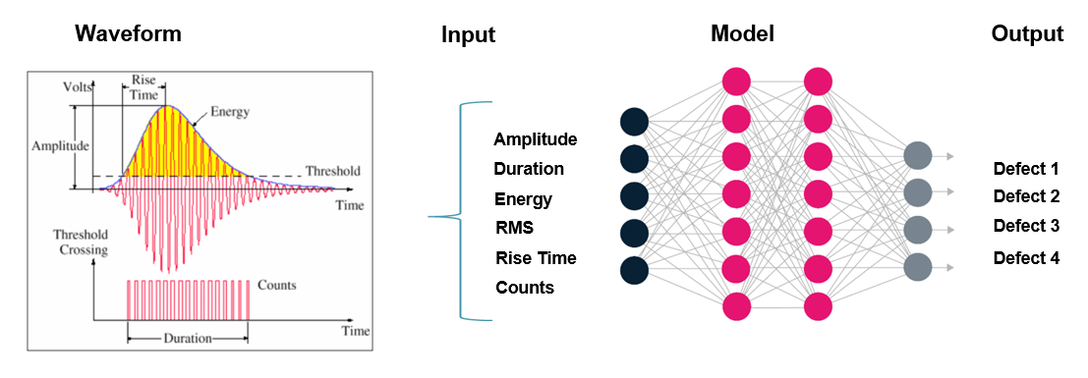
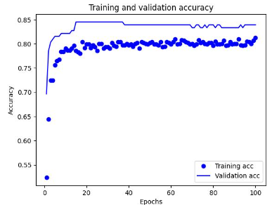
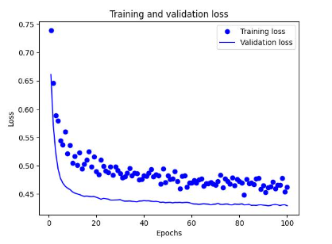
Approach 2: Time Series
Acoustic emission signals generated during the printing process are captured and analyzed to identify patterns associated with various defects. Feature extraction techniques are applied to the acoustic data, and a dense neural network is trained to classify those defects.
Feature extraction and Data Labeling
Model Training and evaluation
DenseNet results

Slide 21
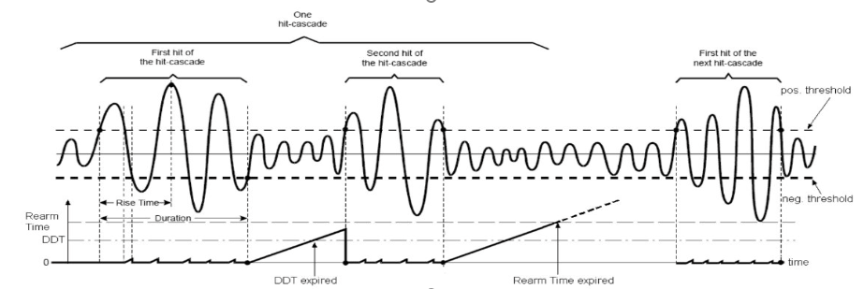
Approach 2: Time Series
Data acquisition parameters setup

Slide 22
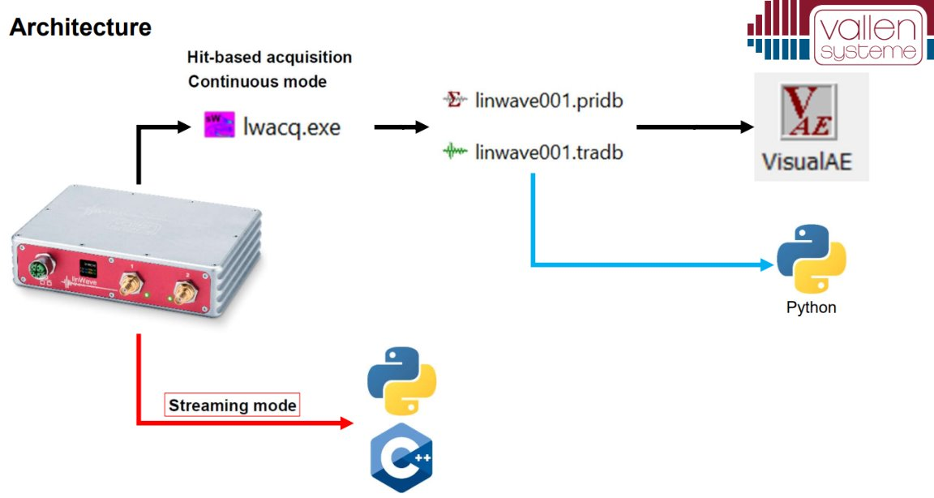
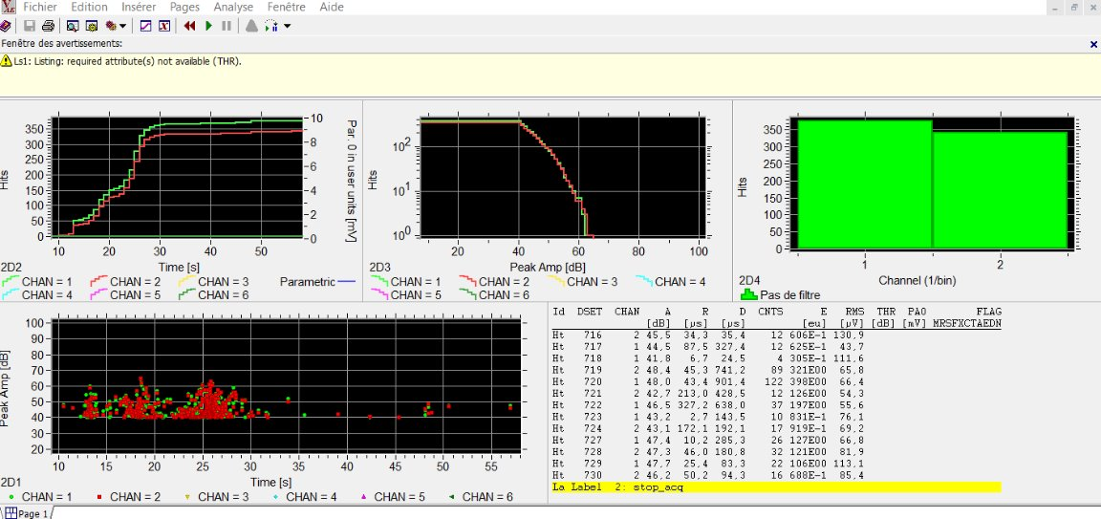
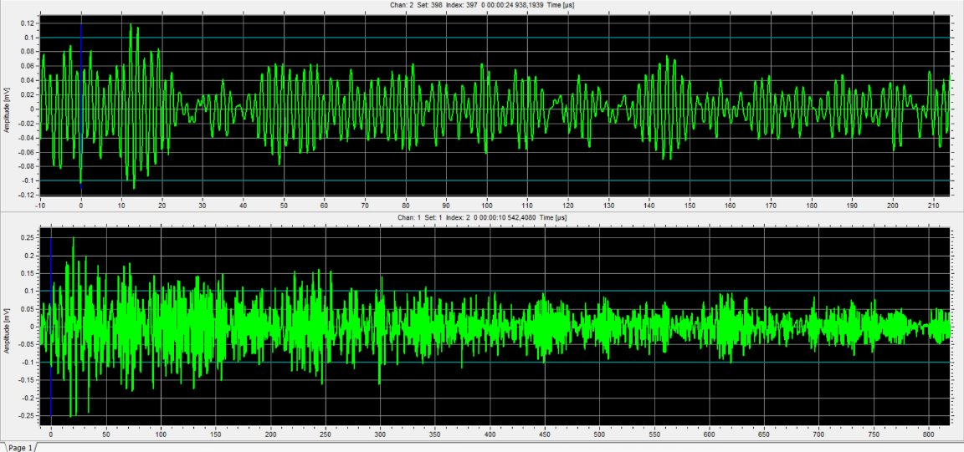
Approach 2: Time Series
Real-time capabilities
Data structures

Slide 23
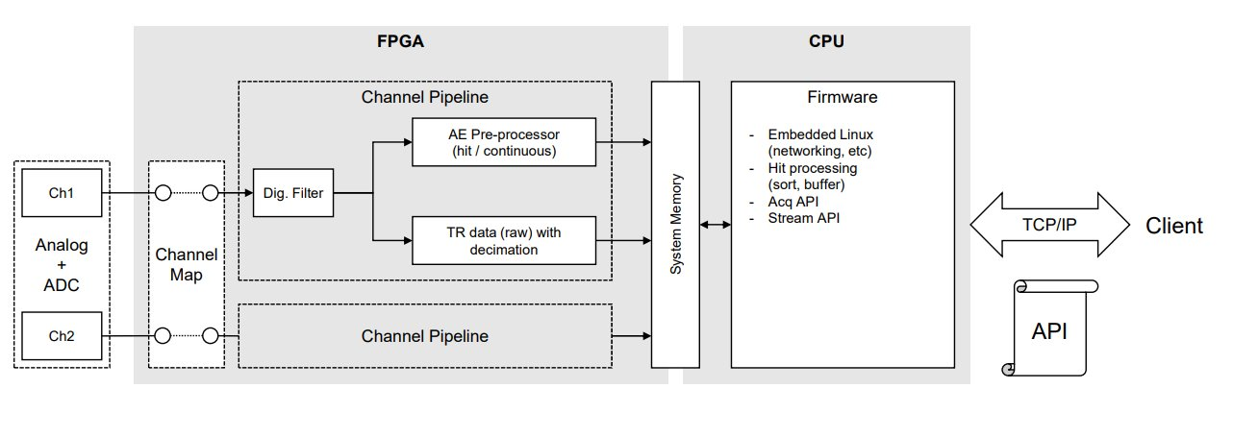
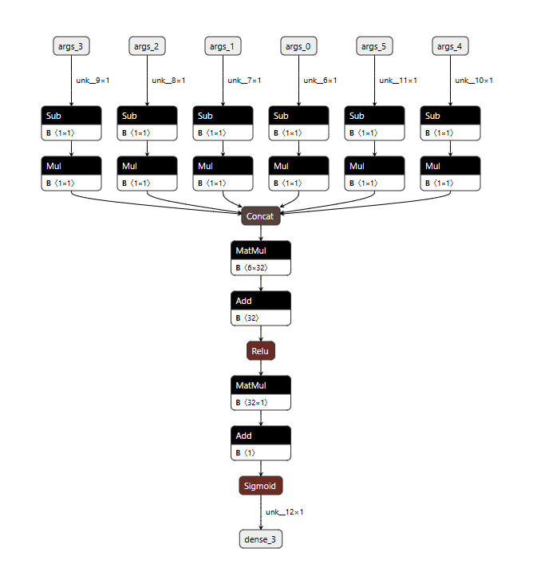
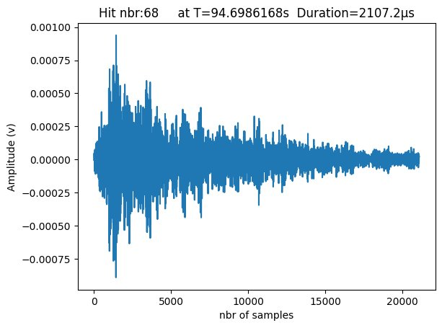
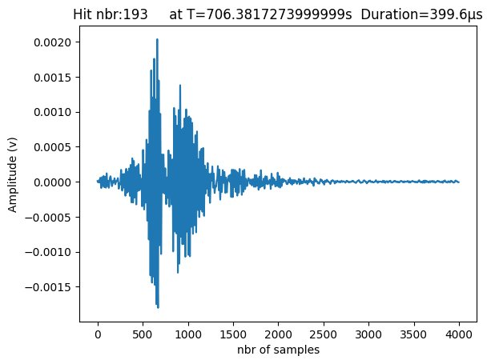
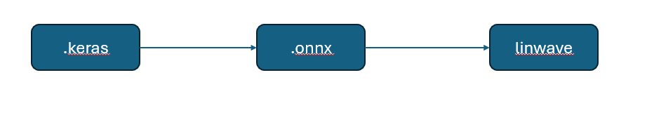
Approach 2: Time Series
Cyber Physical System : edge device

Slide 24





Approach 2: Time Series
Tabulated data
Time series Data
Images: Matrix data

Slide 25




Approach 2: Time Series
Deep-Learning

Slide 26


Approach 2: Time Series
Deployment and Closed-loop setup
Our proposed monitoring system is capable of detecting print defects and adjusting printing parameters to correct them by:
Modifying nozzle temperature
Adjusting flow rate
Pausing the print

Slide 27






Approach 2: Time Series
Deployment and Closed-loop setup
1. Training
printer
AE sensor
Linwave
AE waves
Computer
Labeling/preprocessing/Feature Extraction/splitting
Dataset
anaconda
Python
TensorFlow
Numpy
…….
Keras
Model: Training
Model.Keras

Slide 28
Approach 2: Time Series
Deployment and Closed-loop setup
2. Deployment
OctoPrint
Computer
OctoRest
AE waves
Feature Extraction
printer
AE sensor
Linwave
anaconda
Python
TensorFlow
Numpy
…….
Keras
Model.Keras: Inference
Results

Slide 29

Approach 2: Time Series
Deployment and Closed-loop setup

Slide 30


Time for a hands-on project 3D Printer Connectivity
Plug in AC Adapter (power brick) into a 120 Volt power outlet
Plug in Male USB-C head into Female USB-C port on the Raspberry Pi
Leave power switch in the “off” position as shown below
3. (White cable) Plug in Male USB-A to the top left Female USB-A port of the Raspberry Pi Plug in Male Micro-USB head into the Female Micro-USB port of the Ender 3 V2 3D Printer
4. Plug in NEMA 5-15 plug into a 120 Volt power outlet Plug in male IEC320 C13 plug (opposite end of NEMA 5-15’s cable) into Female IEC320 C13 port of the Ender 3 V2 3D Printer Power on the Ender 3 V2 3D Printer by flipping the switch to “on” position as shown below
2. Plug in Male USB-A from the Logitech C-270 webcam to the top right Female USB-A port of the Raspberry Pi

Slide 31




Time for a hands-on project OctoPrint and Raspberry Pi Setup
5. Locating the IP Address of the Raspberry Pi
Connect both your computer and the Raspberry Pi to the same network, the hot spot setup in the previous step
Download/Install the advanced IP scanner
Search for devices on your network, and locate the Raspberry Pi
d. Copy the IP address of the Raspberry Pi and place into the web
6. Follow the steps outlined by the Octoprint Setup wizard
Download Raspberry Pi Imager
Insert the micro SD card from your Raspberry Pi 4 into a micro SD to SD adapter, then insert into your computer (Do NOT format the SD card on your PC/laptop)
3. Open the Raspberry Pi Imager
Under the “CHOOSE DEVICE” window, select “Raspberry Pi 4”
Under “CHOOSE OS” select the options “Other Specific Purpose OS” > “3D printing” > “OctoPi” and then the “stable” version
Under “CHOOSE STORAGE“ select the option for the micro SD card inserted into the computer
4. Before clicking “NEXT” press “Ctrl + Shift + x” in order to open the “”Advanced options”
Under “Set username and password” enter a new password to use for the system user “pi”. This is not the password you’ll use for logging into OctoPrint, but instead the one that you’ll have to use to log into your Pi via SSH, should you ever need to
Due to the nature of Rowan’s internet setup, create a hotspot using a mobile device instead of using the network “RowanWifi”
Under “Configure wireless LAN” type in the name of the hotspot, which cannot have spaces or special characters, and input the password for the hotspot
Change the “Wireless LAN country” to “US”
Click “SAVE” and then “NEXT” to initiate the process of writing and verifying

Slide 32
Thank you for your attention!
Questions?
kontsos@rowan.edu
bensid28@students.rowan.edu

